Slide 1

DigitalDiary
By the Goofy Goobers Team:
Kene Maduabum, Alianna Card, Megan Land, Nolan Haag

Slide 2
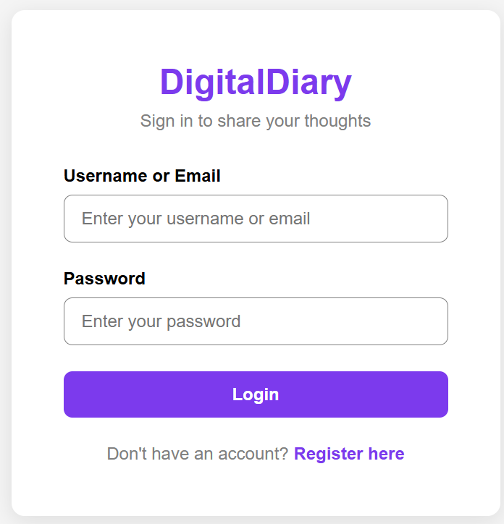
Summary
Problem: Need a simple, secure place to write and organize personal posts and replies.
Goal: Build a small, maintainable MERN app with secure auth, full CRUD, and responsive UI.
Extra: Auth - bcryptjs for hashing + JWT tokens for sessions.

Slide 3
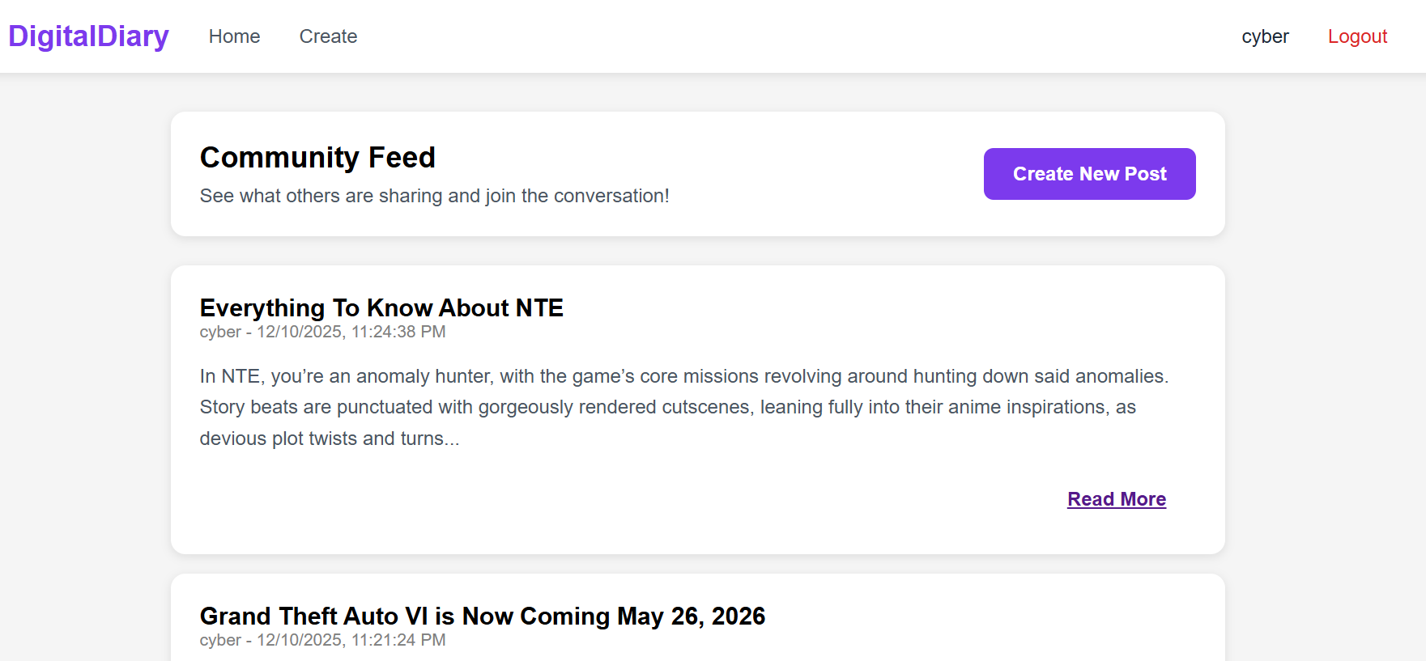
USER FEATURES
Post Management (CRUD): Authenticated users can Create, Read, Edit, and Delete their own posts.
Community Engagement: Post-specific reply functionality using a dedicated Reply Model.
Real-Time Feed: Instantly view the chronological stream of all published community posts.

Slide 4
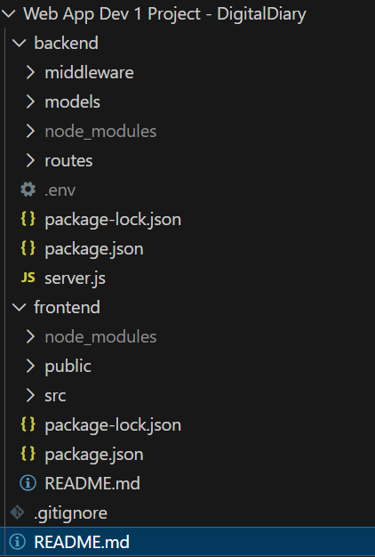

Architecture & Components
Client/Frontend: React (React Router, Axios)
Server/Backend: Node.js + Express (routes & middleware)
DB: MongoDB with Mongoose (User, Post, Reply models)

Slide 5
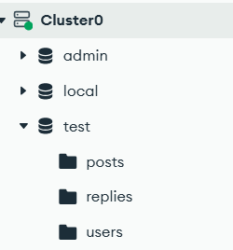
Data Models (Mongoose)
User: username, email, passwordHash, timestamps
Post: author (ObjectId → User), title, content, timestamps
Reply: author, post (ObjectId → Post), content, timestamps

Slide 6

Primary Features
Secure Sign up / Login (bcryptjs + JWT)
Full CRUD for posts (create, read, update, delete)
Reply/comment system attached to posts
Responsive UI with React hooks (useState, useEffect)

Slide 7
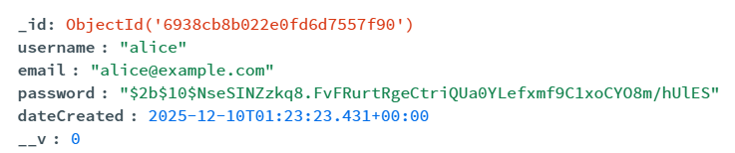
Auth Highlights — Hashing & Token Creation
Passwords never stored in plaintext - passwordHash only
bcrypt with per-password salt (genSalt(10)) to slow brute-force
JWT signed with JWT_SECRET; 7-day expiry
Protected routes via auth middleware reading Authorization header

Slide 8
Frontend: React, Routing & Axios
React Router for navigation (/, /login, /signup, /posts/:id)
Axios instance attaches Authorization header from localStorage
Key components: Navbar, PostPage, RegisterPage, LoginPage
Use of useState and useEffect for state and lifecycle management

Slide 9
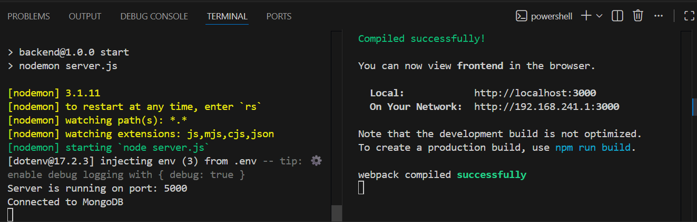
How to Run
Backend: cd backend -> npm install -> create and set .env (MONGO_URI, JWT_SECRET) → npm start
Frontend: cd frontend -> npm install -> npm start

Slide 10

DEMO

